Slide 1
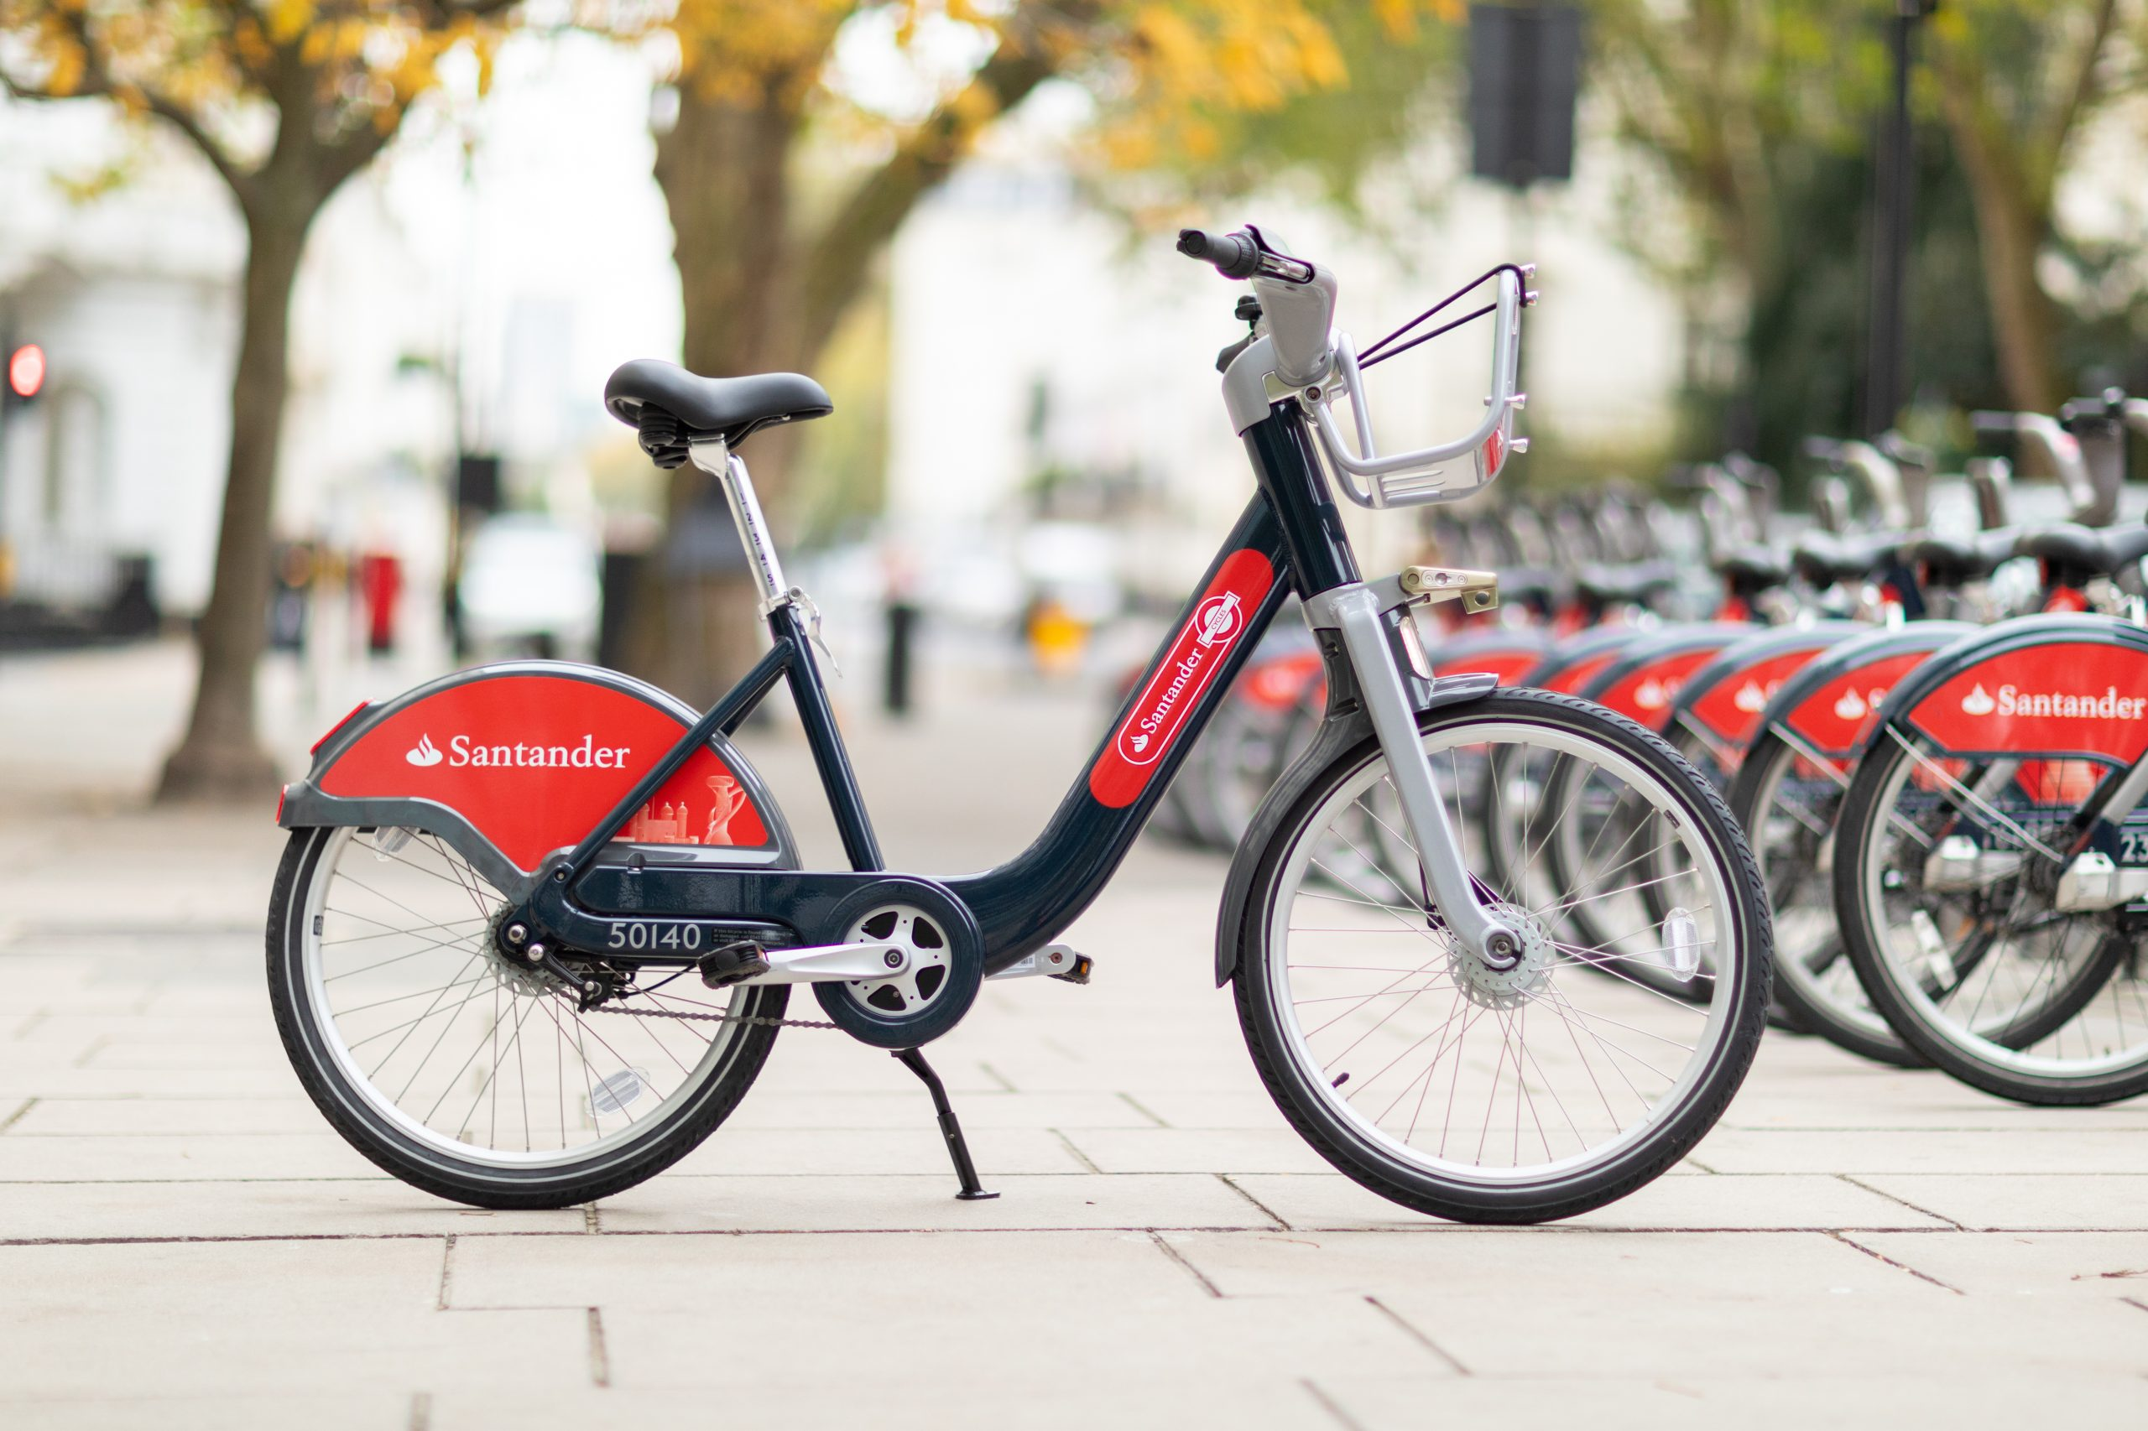
London Bicycles: Data Pipeline & Insights
Data Insights & Opportunities
NTU SCTP DSAI Team 6 | Module 2 Project

Slide 2
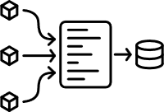

Project Introduction
The London Bicycles project builds an end-to-end data pipeline to analyze public bike usage in London. We will ingest, transform, and validate raw trip data into a structured warehouse for efficient analysis.
Through this pipeline, we will uncover trends in demand, station usage, and rider behavior, while ensuring data quality and scalability. The insights generated support smarter city planning, operational optimization, and improved commuter experience.
Notes:
Melvin

Slide 3
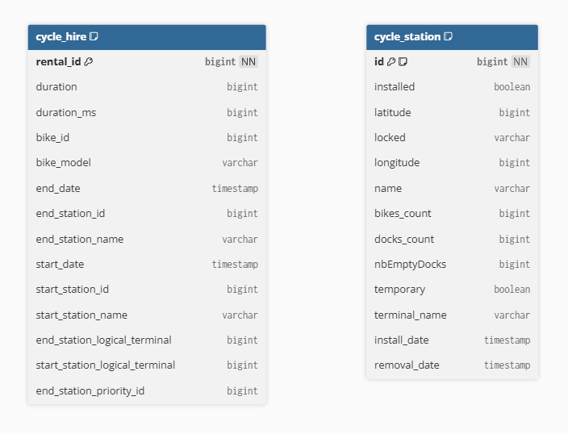



Dataset Overview
Google BigQuery public dataset:
<bigquery-public-data.london_bicycles>
Data Source
4 Jan 2015 – 17 Jan 2023
Time period covered
Cycle_hire -> 84M rows, 14 fields
Cycle_stations -> 800 rows, 13 fields
Data size
Notes:
Melvin

Slide 4
London Bicycles – Framing the Business Challenge
As a city bike-share operator, our challenge is to ensure bikes are in the right place, at the right time, maximizing both customer satisfaction and asset utilization.
We also need to be able to understand consumer behavior to schedule maintenance and optimize pricing strategies.
To do this, we need to understand where demand is strongest, when it peaks, how long rides last, and which routes are popular.
Notes:
Melvin

Slide 5
Insights
A step inwards

Slide 6
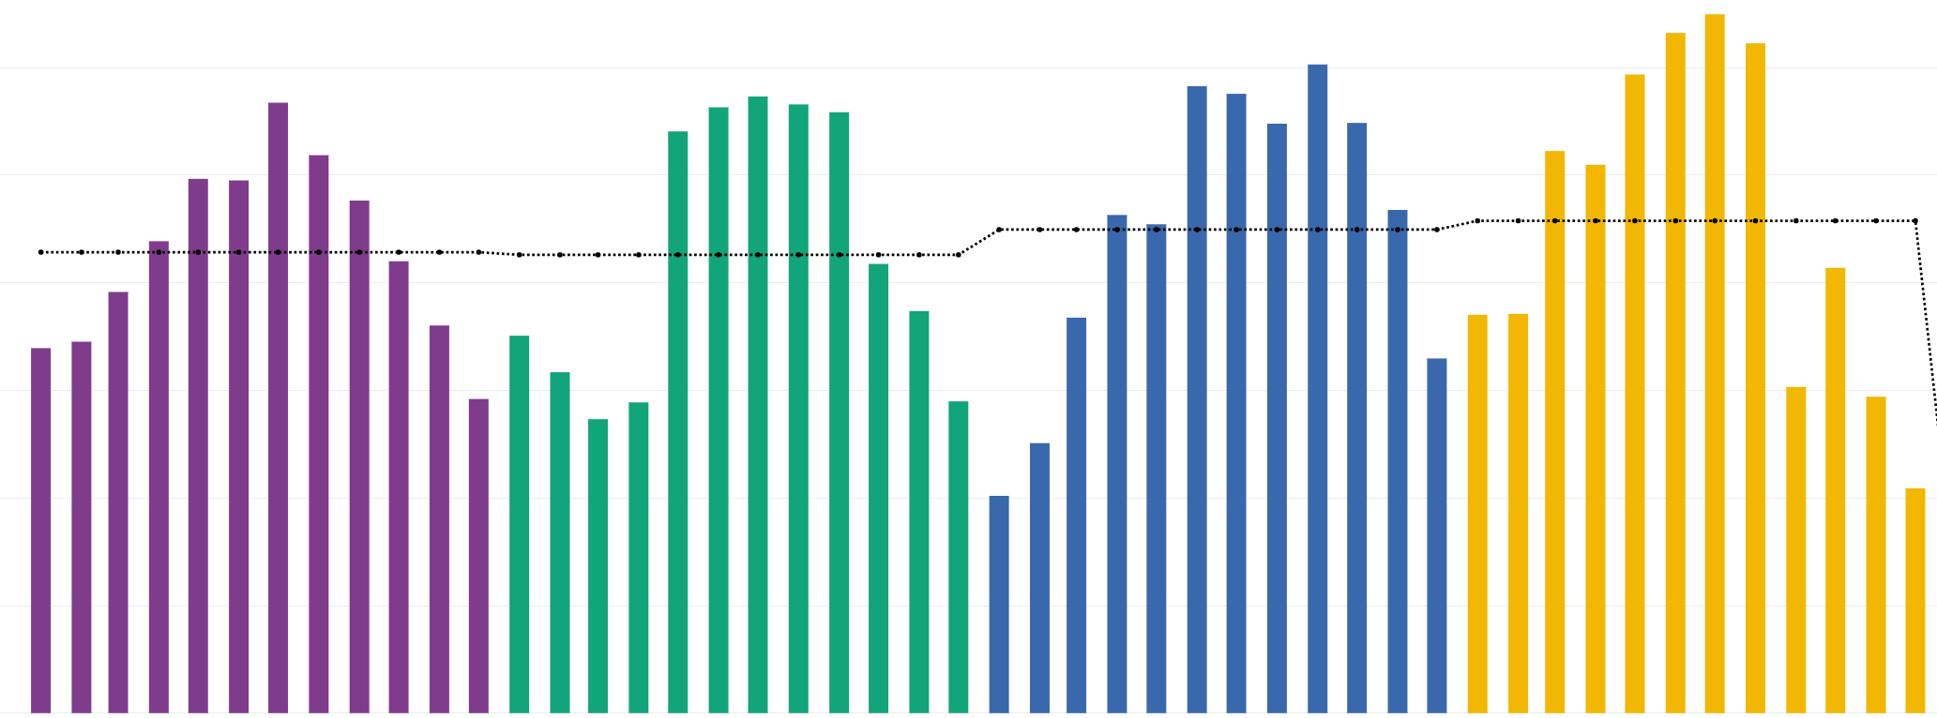
From Pandemic Disruption to Record Highs: What Will Sustain the Momentum?
Monthly Trips (2019-2022)
1.2M
1M
Yearly Average
0.8M
Sustained Growth Post-pandemic
2021 and 2022 reached record highs, with multiple months exceeding 1.2M trips, well above pre-pandemic levels, indicating a structural shift in commuting
0.6M
0.4M
Covid-19 Impact
2020 shows a major drop in Spring (Mar–May), aligning with UK lockdowns. However, strong recovery mid-2020 shows cycling became a preferred socially distanced transport option.
Seasonal Y-on-Y contractions
0.2M
After a record summer in 2022, there’s a sharp drop from Sept amidst price changes and e-bike roll outs.
0
Jan 2019
Jul 2019
Jan 2020
Jul 2020
Jan 2021
Jul 2021
Jan 2022
Jul 2022

Slide 7
Usage Trends and Patterns
Daily Cycle Patterns
Clear commuter peaks
Morning peak at 8 AM (2,400–2,900 trips)
Evening peak at 5–6 PM (3,200–3,600 trips)
Leisure and non-commute rides
Steady use 11 AM – 3 PM (1,200–2,000 trips)
Low overnight usage
12 AM – 5 AM trips are minimal (<200–400)
Seasonal Variations
Weather effects
Q2 (Spring) and Q3 (Summer) have the highest usage across the year, likely due to warmer weather.
Tourism effect
The marked difference between morning and evening commuter peaks vis-à-vis Q2 and Q3 may be due to tourism.
Transport for London pricing changes
Q4 (Autumn) should behave more like Spring but this drop in usage was due to repricing actions – £2 unlimited 30 mins Day pass to £1.65/30 mins

Slide 8
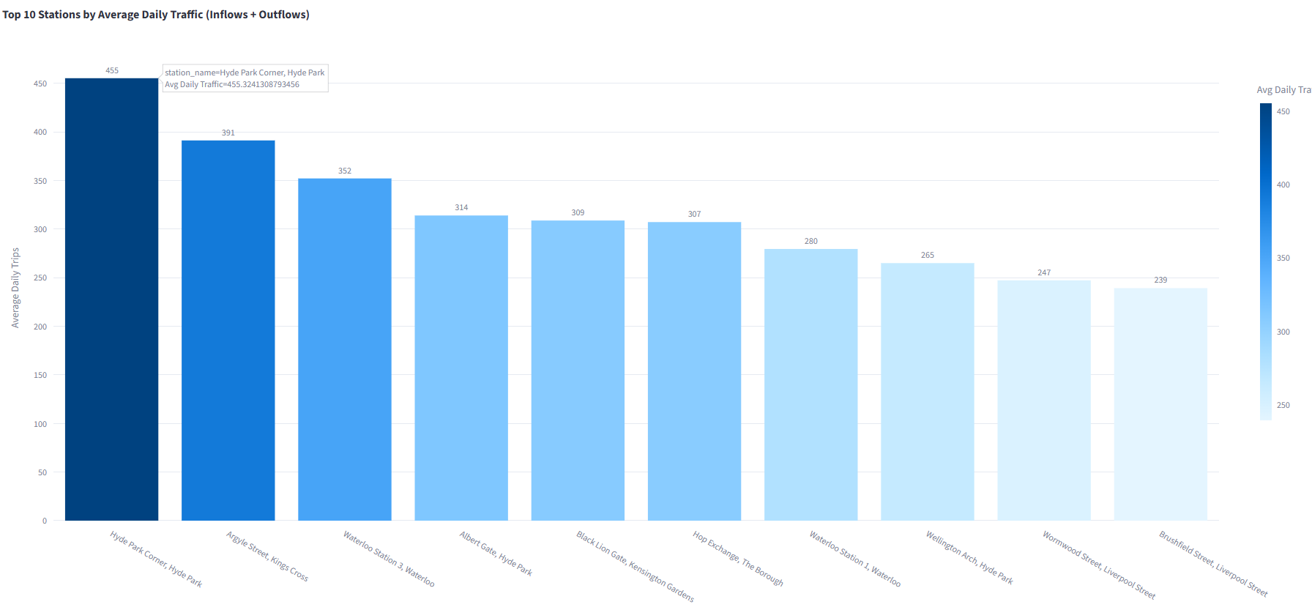
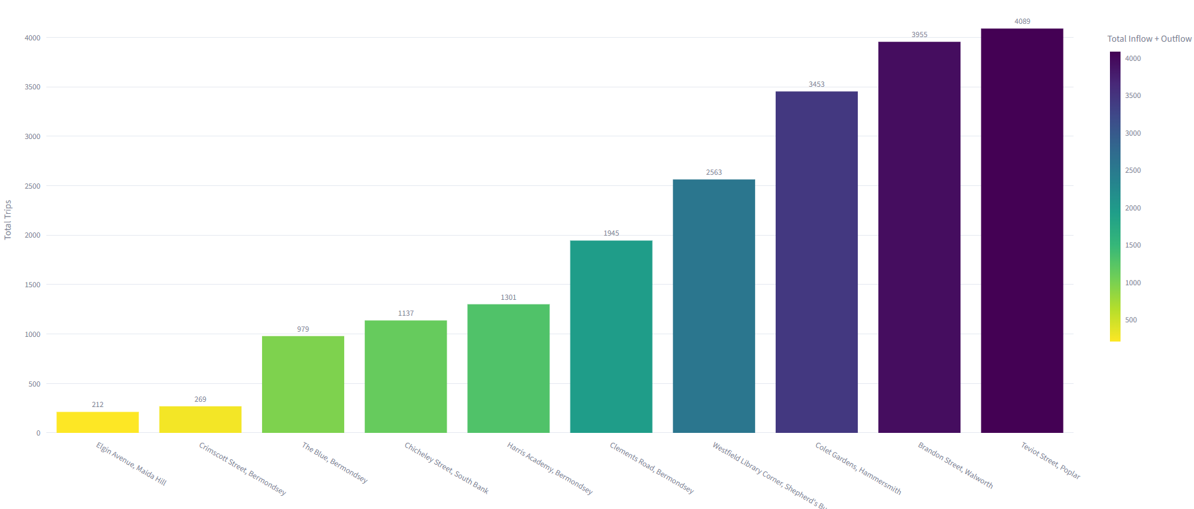
When Some Stations Struggle While Others Surge – How Do We Rebalance?
High Volume Hubs
High-volume hubs quickly run out of bikes or docks, requiring constant redistribution.
Reactive rebalancing costs are higher, further study needs to be done to weigh the costs of building new stations vs restribution
Struggling stations underutilization
A two-pronged approach of rebalancing from underutilized stations as well as stimulation of demand in weaker stations through tiered discounts

Slide 9
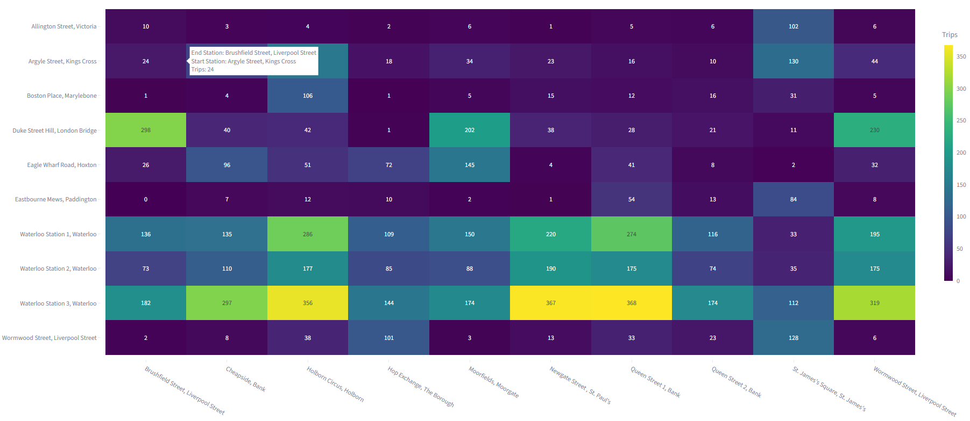
Are Riders Redefining What a Trip Looks Like?
Top Start-End Station Routes
Start Stations
High-frequency corridors show the shift
Santander Cycles are becoming London’s last-mile connector, with pricing causing a shift towards a more optimized journey planning through prime connector hubs
Post pricing adjustments
From longer commuter rides to quick hops: a structural shift or short-term adjustment?
0 - <15 mins
15 - <30 mins
30 - <45 mins
45 - <60 mins
End Stations

Slide 10
Recommendations
Strong seasonal swings: higher in spring/summer, lower in winter. Actionable Insight:
Schedule rebalancing crews around commuter peaks.
Use off-peak promotions to smooth demand.
Plan maintenance during low-season months.
Repricing has caused structural shifts
Actionable Insights:
Reinstating a more expensive day pass to increase trip counts.
Proximity based pricing to encourage demand for restribution

Slide 11
Streamlit
A visual journey
Notes:
Anjan + Priya

Slide 12
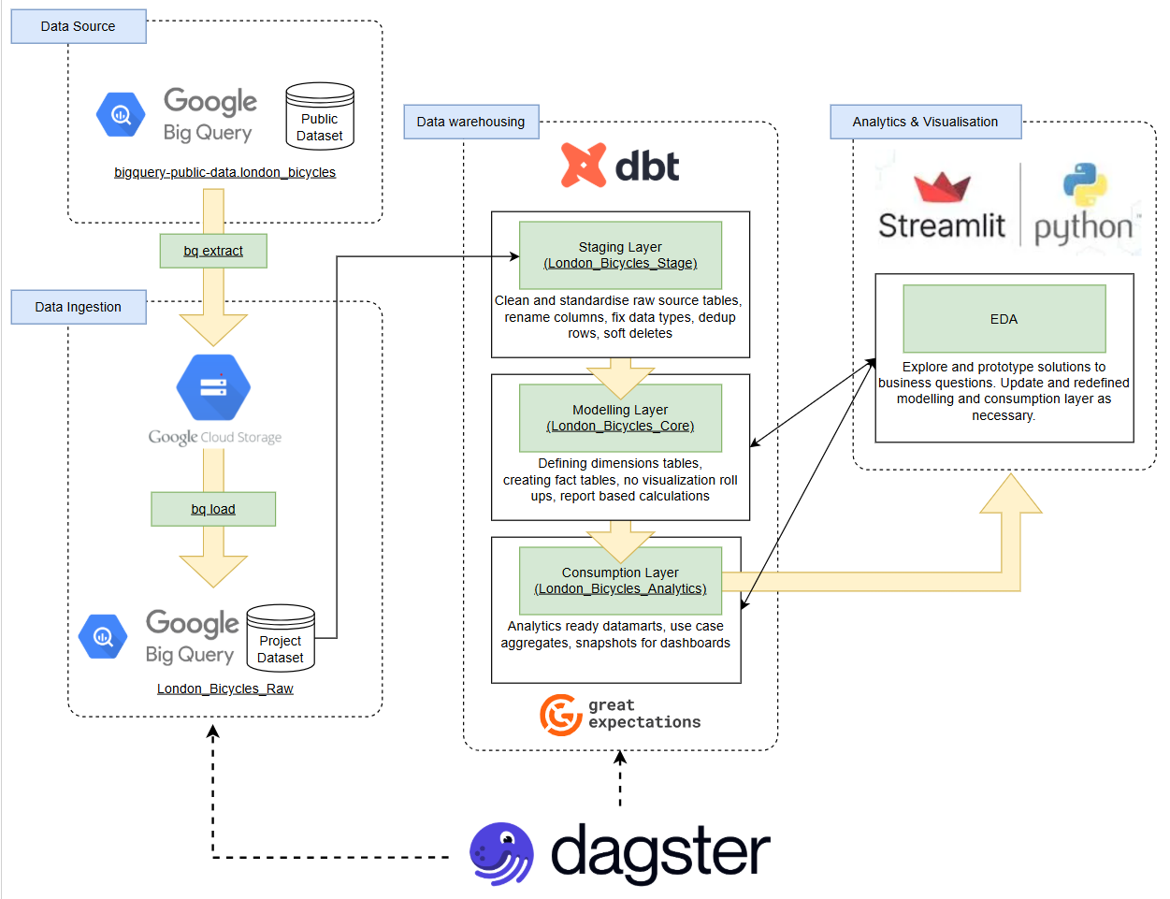
Methodology
DATA INGESTION
DATA WAREHOUSE DESIGN
ELT PIPELINE
DATA EXPLORATION AND QUALITY
ANALYSIS
Notes:
Raymond

Slide 13
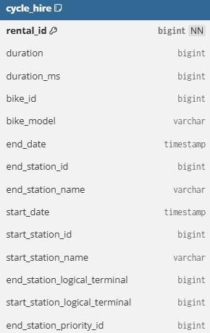
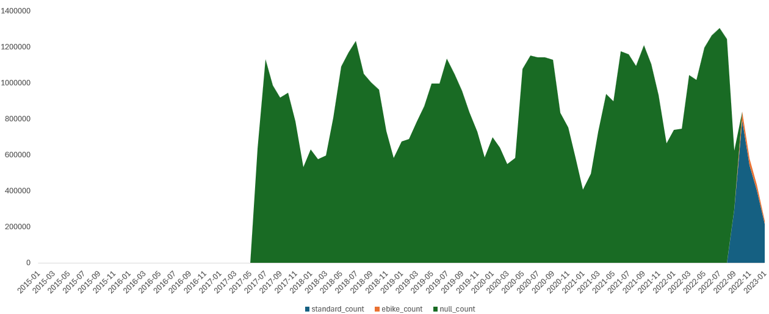
Data Exploration
Schema is not comprehensive, but volume of records is very high (83M+)
5M+ null or invalid station ids
19K+ duration nulls & ~30K duration > 1 days
Date and Timestamp Rationalisation
Insignificant information:
Bike models - E-bikes were introduced to London's Santander Cycles scheme on October 6, 2022, when 500 electric pedal-assist bikes were added to the existing fleet.
Logical Terminal
Empty Docks
Unique ride ID
Duration in seconds
Duration in milliseconds, redundant
Bike identifier
Bike Model - Classic/E-BIKE
Timestamp when rental ends
ID of station bike is returned to
Name of station bike is returned to
Timestamp when rental starts
ID of station bike is rented from
Name of station bike is rented from
Always NULL
Always NULL
Always NULL
Notes:
JP

Slide 14


Data Pipeline
Cleansing, Transformation and Validation
Raw Data
cycle_hire_raw
cycle_stations_raw
Staging
stg_cycle_hire
stg_cycle_stations
Model
dim_stations
dim_dates
fact_trips
Analytics
daily_summaries
duration_band
Hourly_counts
monthly_summaries
return_to_origin
route_popularity
station_demand_supply
top_stations
trip_duration_histogram
weekly_summaries
Data Cleansing
Start Station ID/End Station ID are null or invalid ~5M+
Station Names instead of station ID can be used as reference >> Cleanse based on Station Name
Timestamp is stored as Integer not suitable for time/date-based analysis >> Converted to proper timestamp and date.
Data Transform
Extract Area from Station Names
dim_dates to support fast access to date fields for efficient reporting
Analytics tables created to support faster access for visualisation since the volume of data in fact_trips is 83M+
Check on the permissible null value (upto 2%)
Check on valid station ids
Check on valid duration < 24hrs
Checks performed on both raw and staging tables to compare before & after snapshots

Slide 15


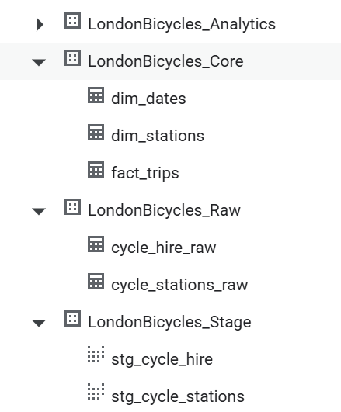
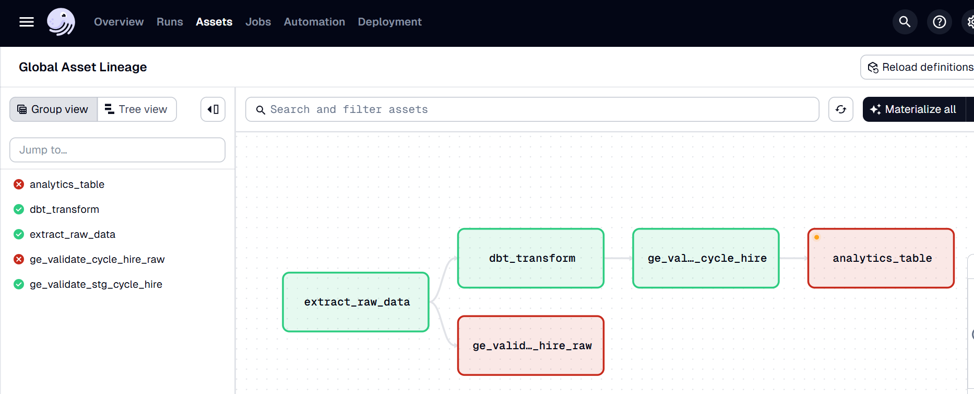
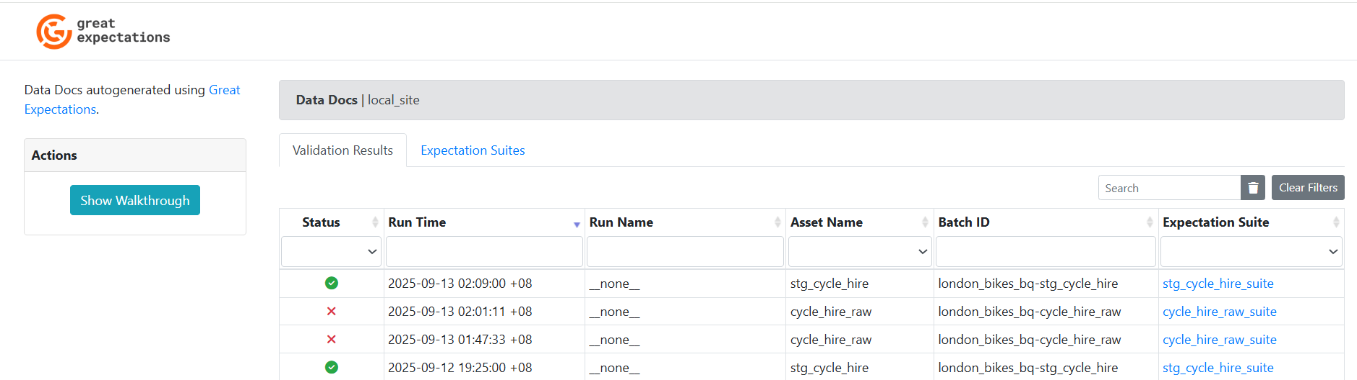
Orchestration & Checkpoints

Slide 16
Closing Summary
Further Enhancements
Demand Forecasting
Anomaly Detection (Flag abnormal spikes/drops in hires (e.g., strikes, outages, big events).)
Route Recommendation for e.g. Popular routes between stations, Suggestion engine for tourists
Optimization, Use analysis to identify under-served areas, bike rebalancing logistics: predict where to move bikes.
Additional Data that could have helped
Road closures, Public Transport Information
Weather
Holiday/Event Calendars
Key Reflections
Limited dataset but team continuously striving to find more insights
Setting up orchestration tools (Dagster) and debugging import/env issues.
Data validation logic (e.g., null checks, station mismatches).
Using architectural thinking to design a scalable pipeline.
Excellent Teamwork, Collaboration and Strong Commitment to deliver

Slide 17


Questions & Answers

